Slide 1

Autonomous Inductively Charged Quadcopter

Slide 2
Team Overview
Sean McQuay (Electrical Engineer)
Airborne Components
Bryan Murphy (Electrical Engineer)
Inductive Power Transfer
Steven Sumpter (Electrical Engineer)
Inductive Power Transfer

Slide 3
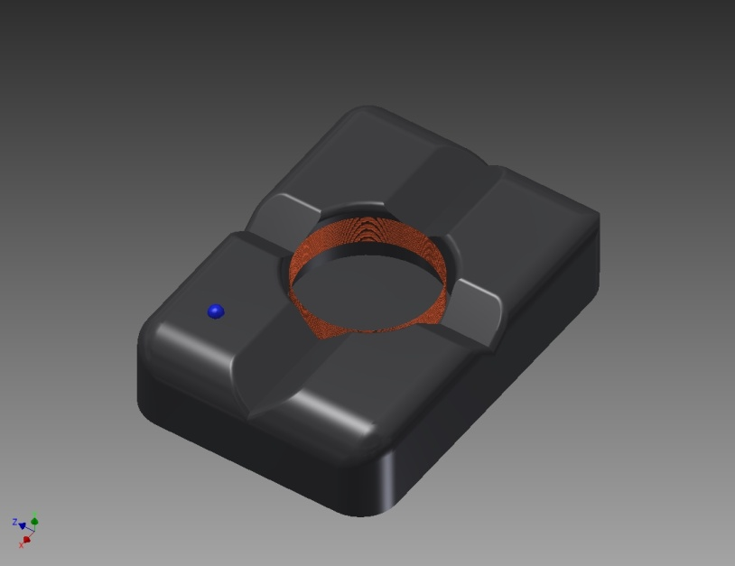
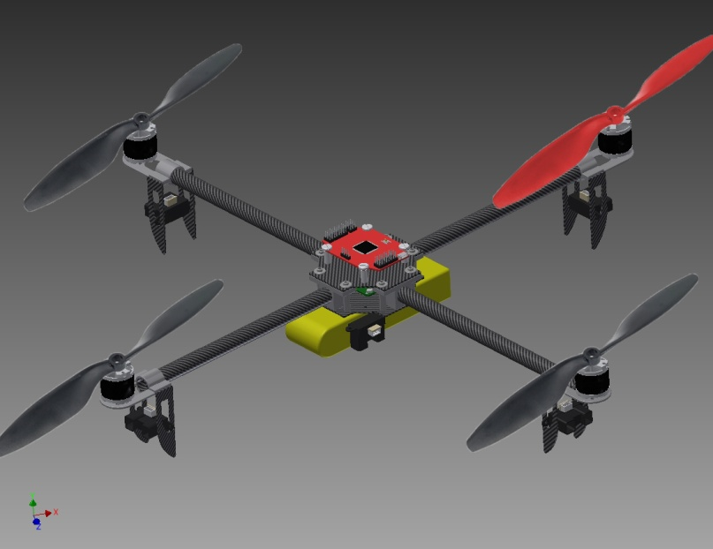
Project Synopsis
Airborne Components
Inductive Power Transfer

Slide 4
Project Objectives
Quadcopter Lift Capacity
Quadcopter Mass: 1.456 kg
Generated Thrust: 3.560 kg

Slide 5
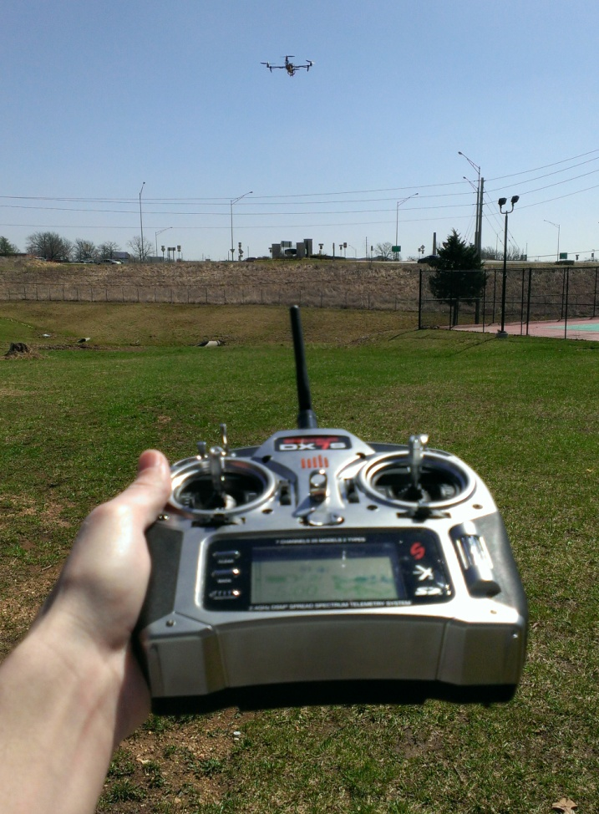

Project Objectives
Autonomous Position Hold
Autonomous Waypoint Navigation

Slide 6
Project Objectives
Autonomous Obstacle Avoidance

Slide 7
Project Objectives
Inductive Power Transfer

Slide 8
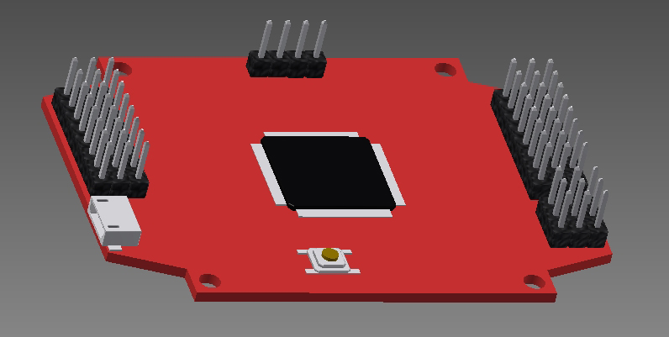
Airborne Components
Flight Controller
Accelerometer
Gyrometer
Magnetometer
GPS Interface

Slide 9
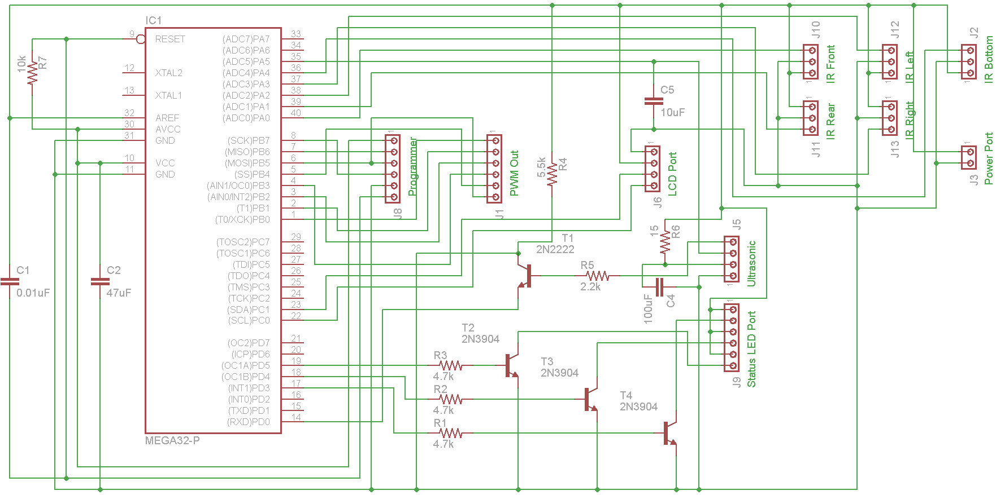
Airborne Components
Interface Controller

Slide 10
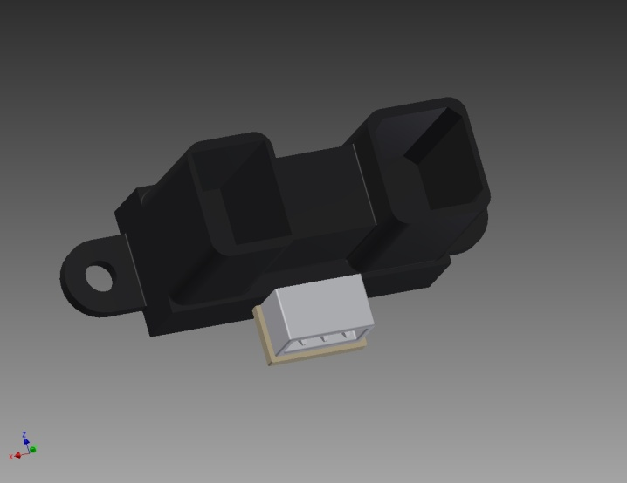
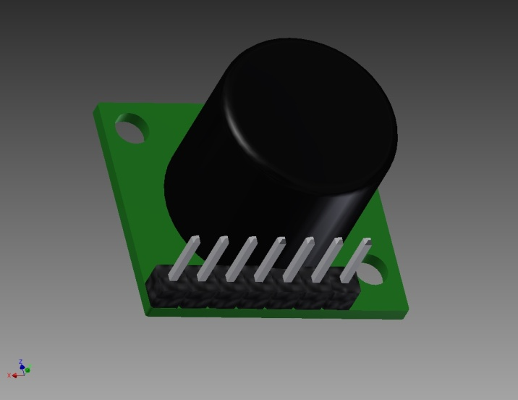
Airborne Components
External Feedback
Sharp IR Rangefinder (~130cm)
Maxbotix Ultrasonic Rangefinder (~648cm)

Slide 11

Airborne Components
Summation

Slide 12
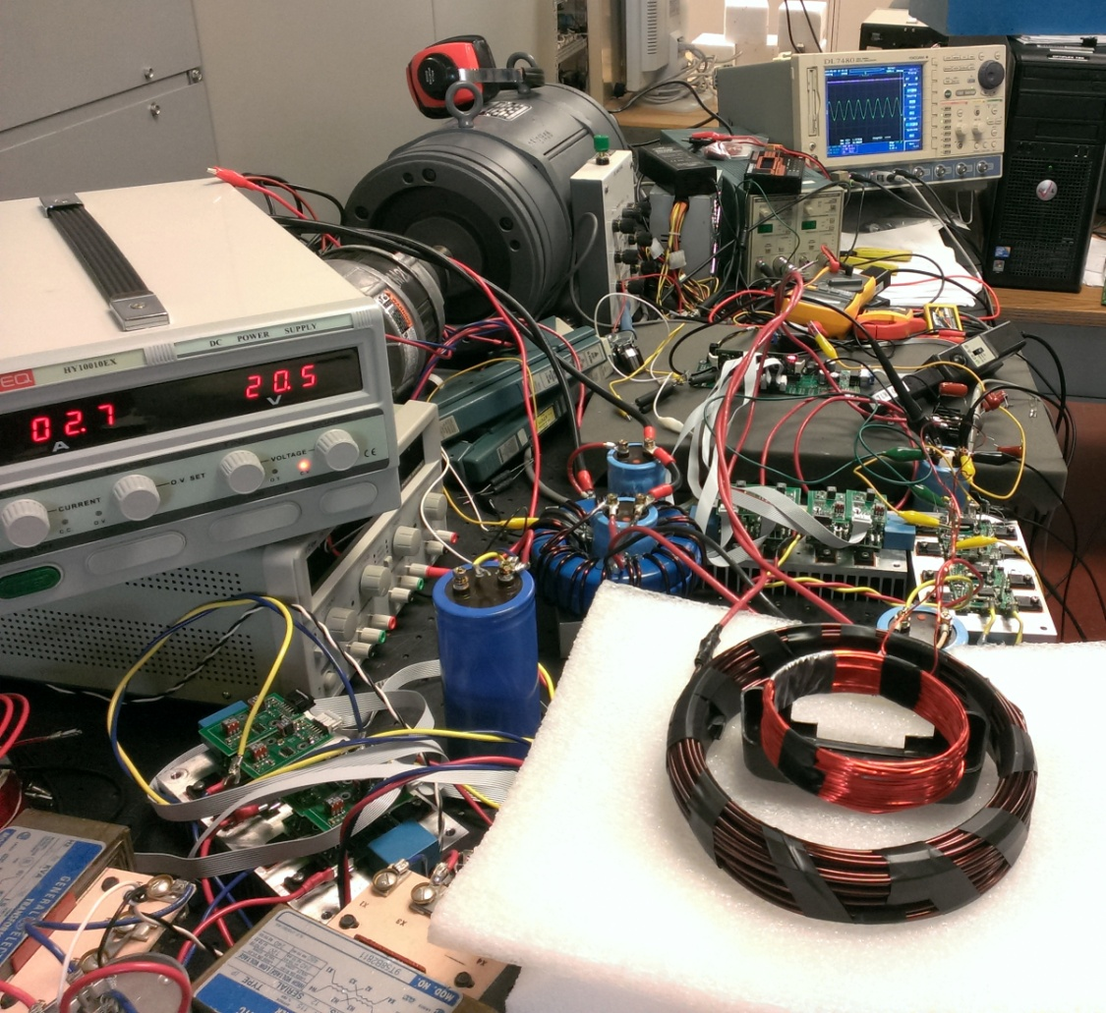
Inductive Transfer
Charging Base

Slide 13
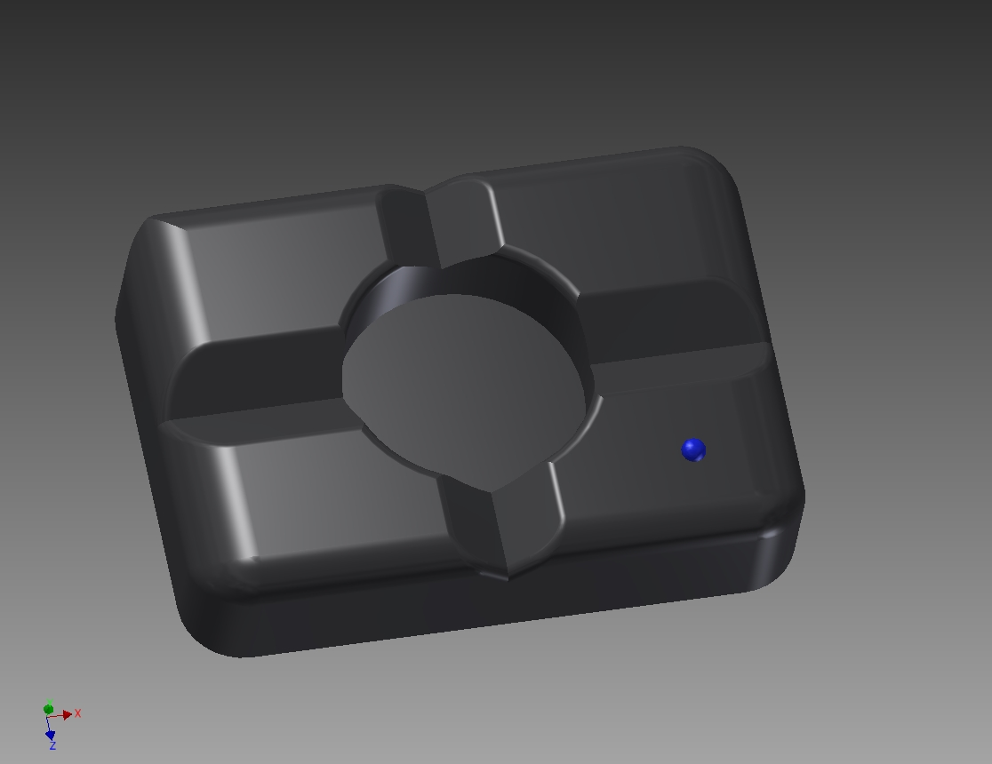
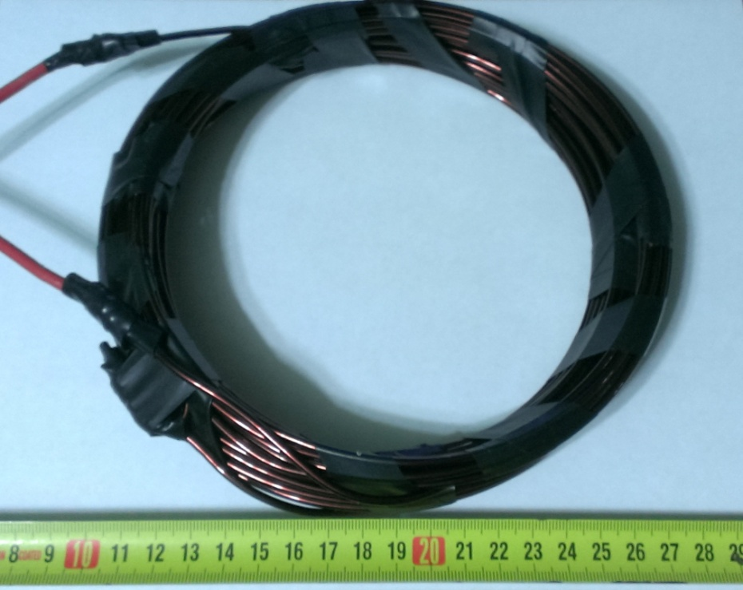
Inductive Transfer
Primary Coil (Terrestrial Location)

Slide 14
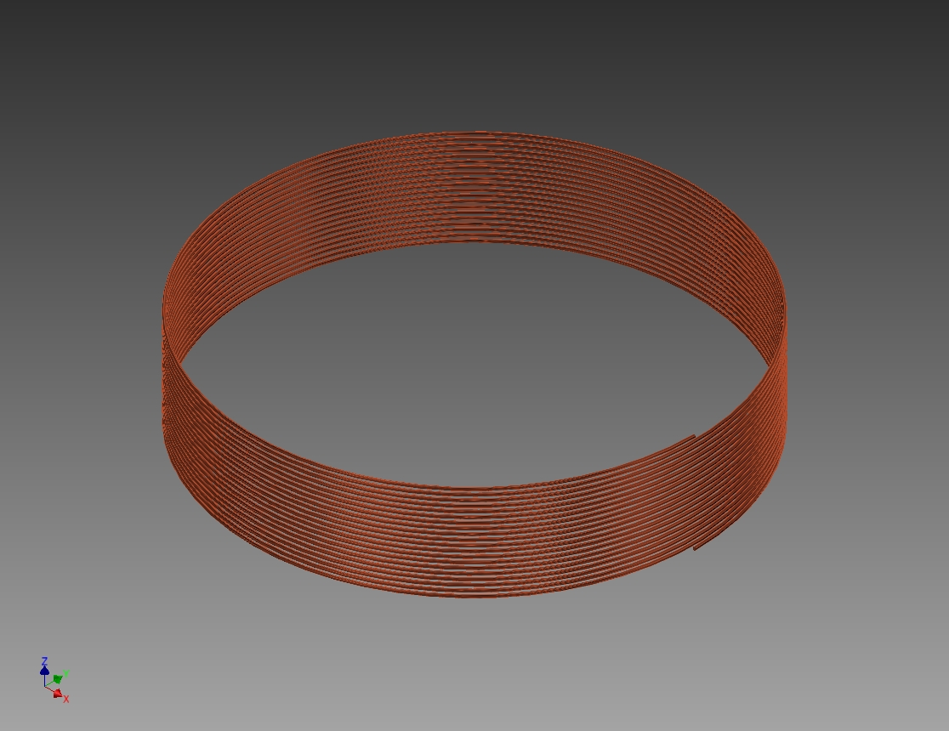
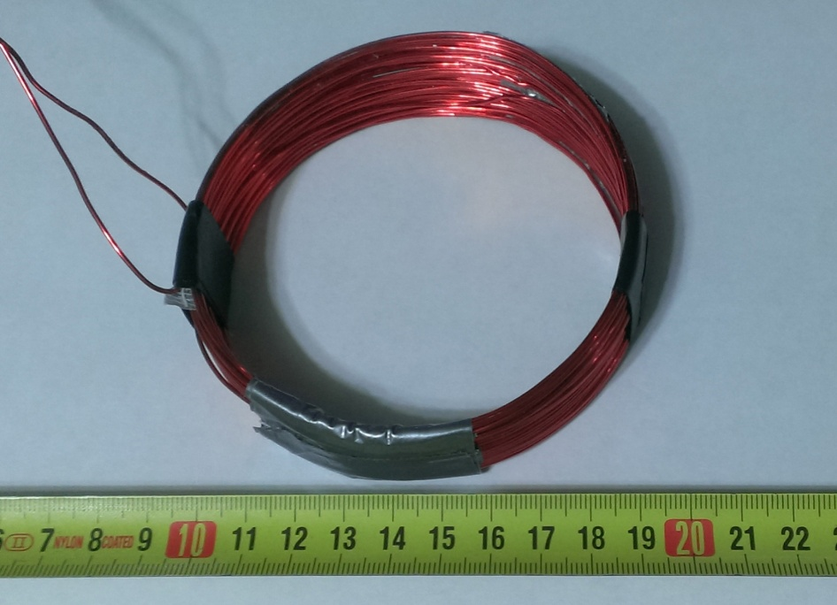
Inductive Transfer
Secondary Coil (Airborne Location)

Slide 15
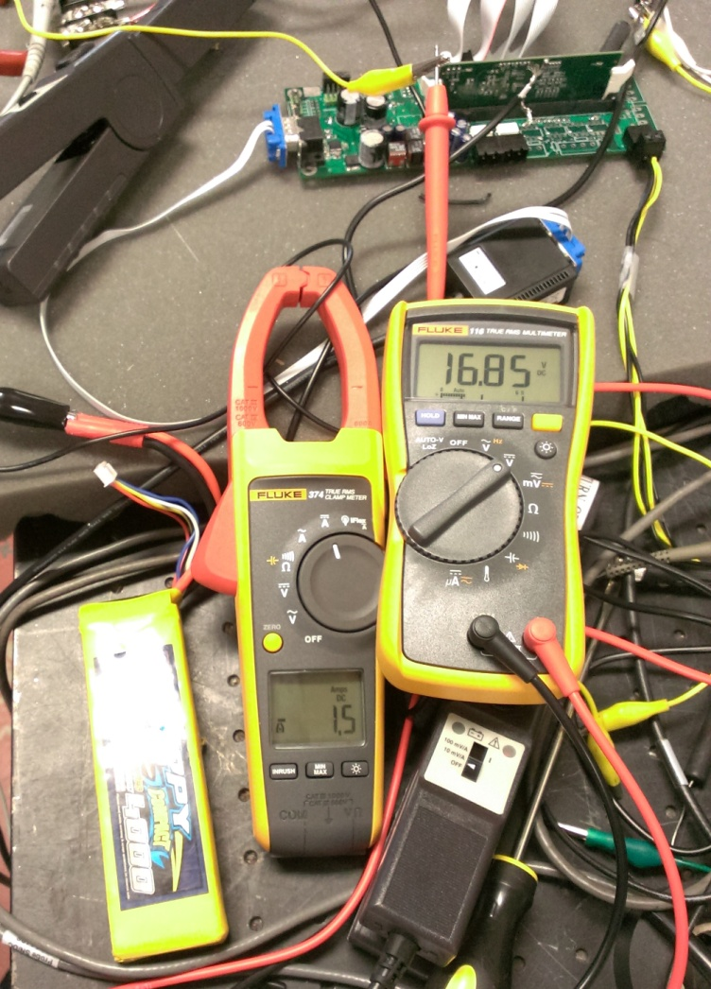
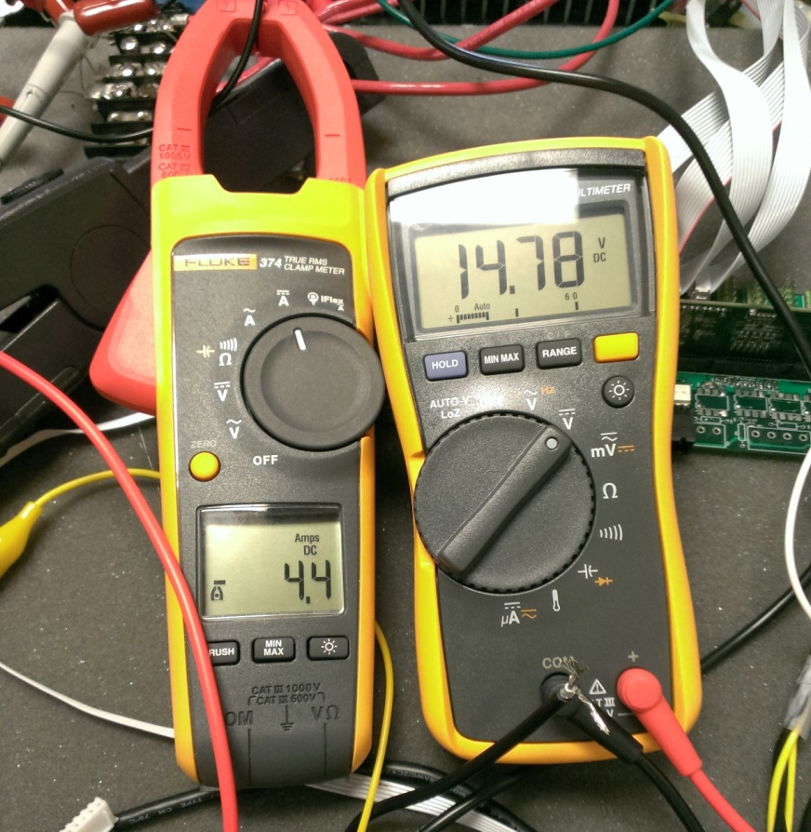
Inductive Transfer
Coupling Efficiency: ~30%
Power Transfer: >100W

Slide 16
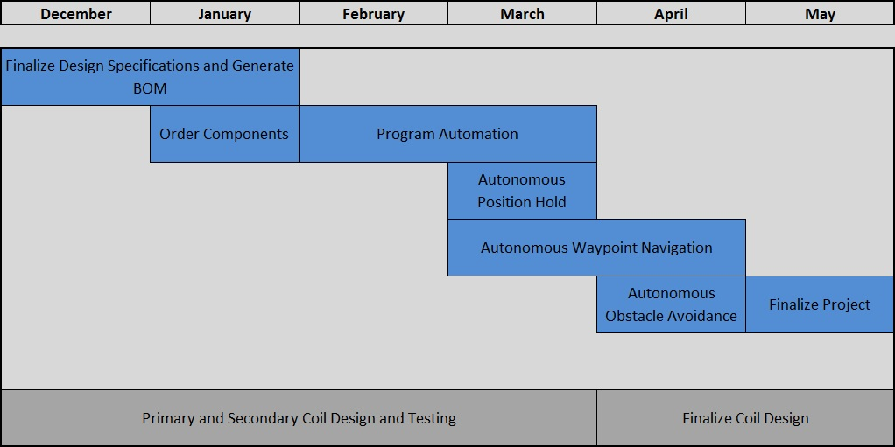
Projected Timeline

Slide 17
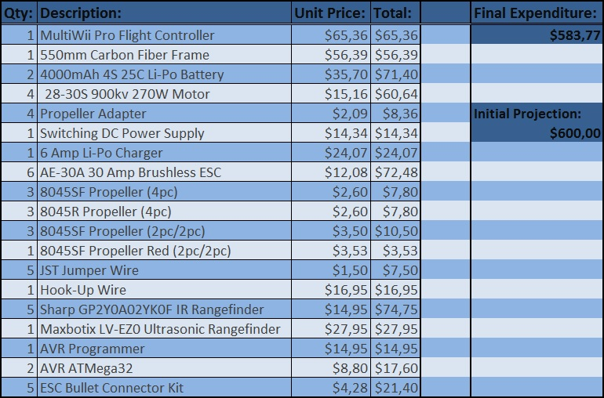
Finalized Budget

Slide 18
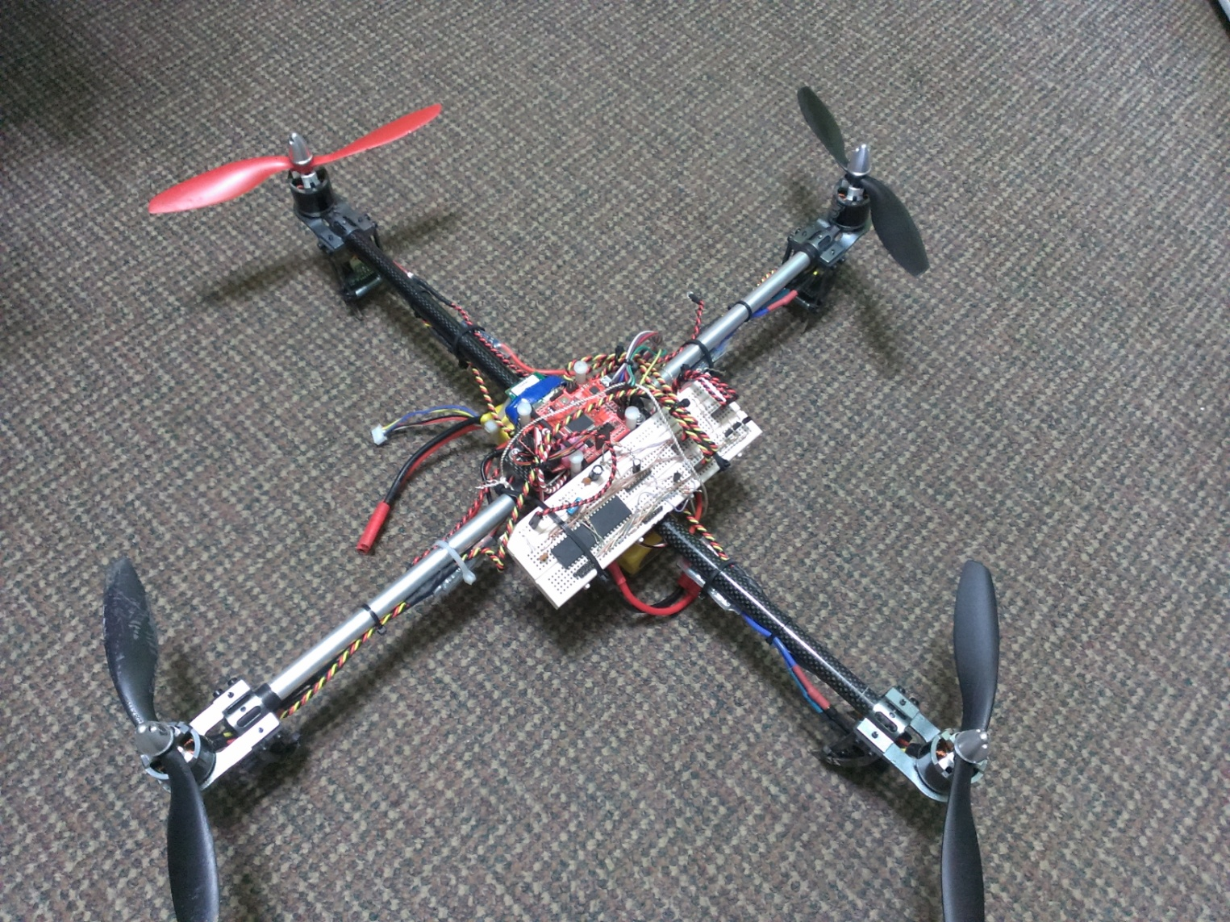
Project Summation

